Slide 1
Machine Learning
Course Code: AFI 124

Slide 2
Previous Class
Artificial Intelligence AI, AI Perspectives: acting and thinking humanly, acting and thinking rationally
History of AI
Foundations of AI: Philosophy, Economics, Psychology, Sociology, Linguistic, Neuroscience, Mathematics, Computer Science, Control Theory
Applications of AI
Handson Github

Slide 3
Contents
Introduction to Machine Learning, Concepts of Learning, Supervised, Unsupervised and
Reinforcement Learning
Statistical-based Learning: Naive Bayes Model
Learning with Neural Networks: Introduction, Biological Neural Networks Vs. Artificial Neural Networks (ANN), Mathematical Model of ANN, Activation Functions: Linear, Step Sigmoid, Types of ANN: Feed-forward, Recurrent, Single Layered, Multi-Layered, Application of Artificial Neural Networks, Learning by Training ANN, Supervised vs. Unsupervised Learning, Hebbian Learning, Perceptron Learning, Back - propagation Learning

Slide 4
Machine Learning
Machine learning is about extracting knowledge from the data. It can be defined as,
“Machine learning is a subfield of artificial intelligence, which enables machines to learn from past data or experiences without being explicitly programmed.”

Slide 5
1.1. Concept of Machine Learning
Supervised
Unsupervised

Slide 6
1.1. Concept of Machine Learning: Supervised Learning
In supervised learning the agent observes input-output pairs and learns a function that maps from input to output.

Slide 7
1.1. Concept of Machine Learning: Unsupervised Learning
In unsupervised learning the agent learns patterns in the input without any explicit feedback. The most common unsupervised learning task is clustering.

Slide 8
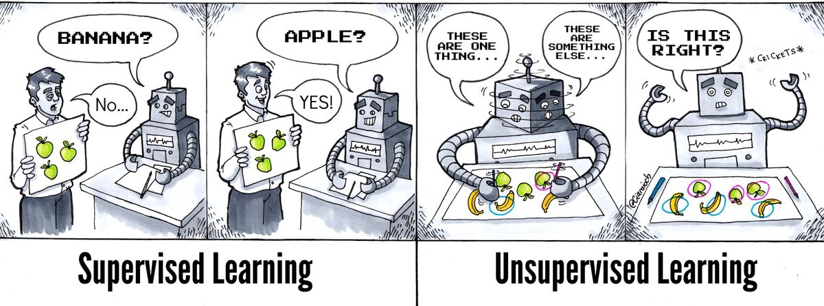
Supervised and Unsupervised Learning
Supervised machine learning relies on labelled input and output training data.
Algorithms: Nearest Neighbor, Naive Bayes, Decision Trees, Linear Regression, Support Vector Machines (SVM), Neural Networks
unsupervised learning processes unlabelled or raw data.
Algorithms: K-means Clustering, Affinity clustering etc.

Slide 9
2. Reinforcement Learning
Method aims at using observations gathered from the interaction with the environment to take actions that would maximize the reward or minimize the risk. Reinforcement learning algorithm (called the agent) continuously learns from the environment in an iterative fashion. In the process, the agent learns from its experiences of the environment until it explores the full range of possible states.

Slide 10
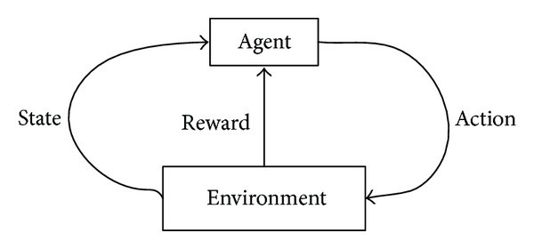
2. Reinforcement Learning
In order to produce intelligent programs (also called agents), reinforcement learning goes through the following steps:
Input state is observed by the agent.
Decision making function is used to make the agent perform an action.
After the action is performed, the agent receives reward or reinforcement from the environment.
The state-action pair information about the reward is stored.
Use cases:
Some applications of the reinforcement learning algorithms are computer played board games (Chess, Go), robotic hands, and self-driving cars.

Slide 11
3. Statistical-based Learning: Naive Bayes Model
Naive Bayes Model is a classification technique based on Bayes' Theorem with an assumption of independence among predictors. In simple terms, a Naive Bayes classifier assumes that the presence of a particular feature in a class is unrelated to the presence of any other feature.
For example, a fruit may be considered to be an apple if it is red, round, and about 3 inches in diameter. Even if these features depend on each other or upon the existence of the other features, all of these properties independently contribute to the probability that this fruit is an apple and that is why it is known as ‘Naive’.

Slide 12
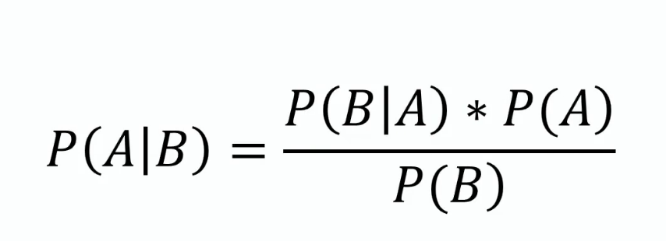
Bayes Theorem

Slide 13
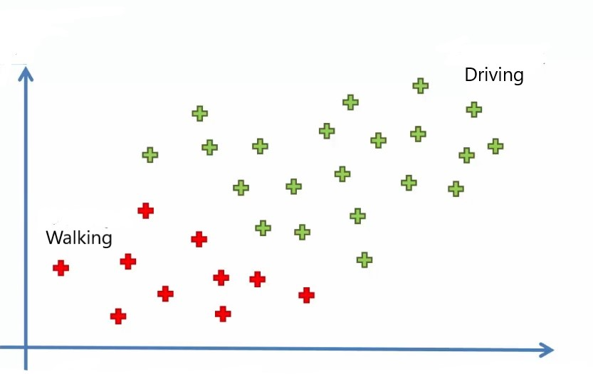
Naive Bayes Model Example
Notes:
Src: https://www.analyticsvidhya.com/blog/2021/01/a-guide-to-the-naive-bayes-algorithm/

Slide 14
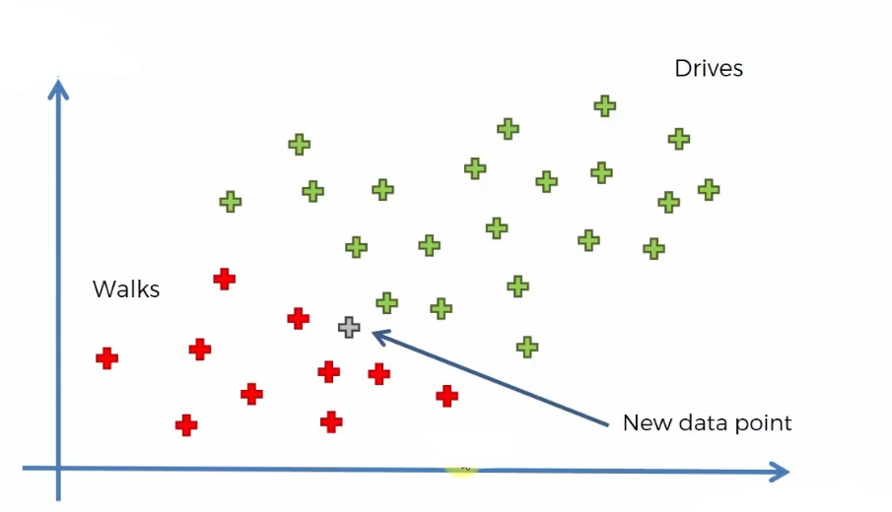
Naive Bayes Model Example
Notes:
Src: https://www.analyticsvidhya.com/blog/2021/01/a-guide-to-the-naive-bayes-algorithm/

Slide 15
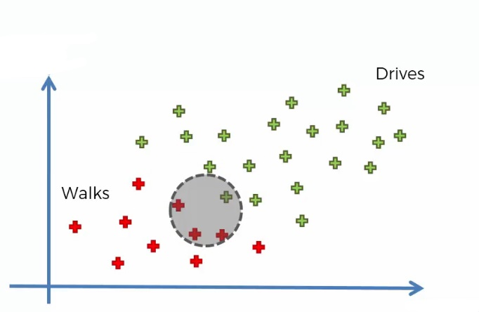
Naive Bayes Model Example
Notes:
Src: https://www.analyticsvidhya.com/blog/2021/01/a-guide-to-the-naive-bayes-algorithm/

Slide 16
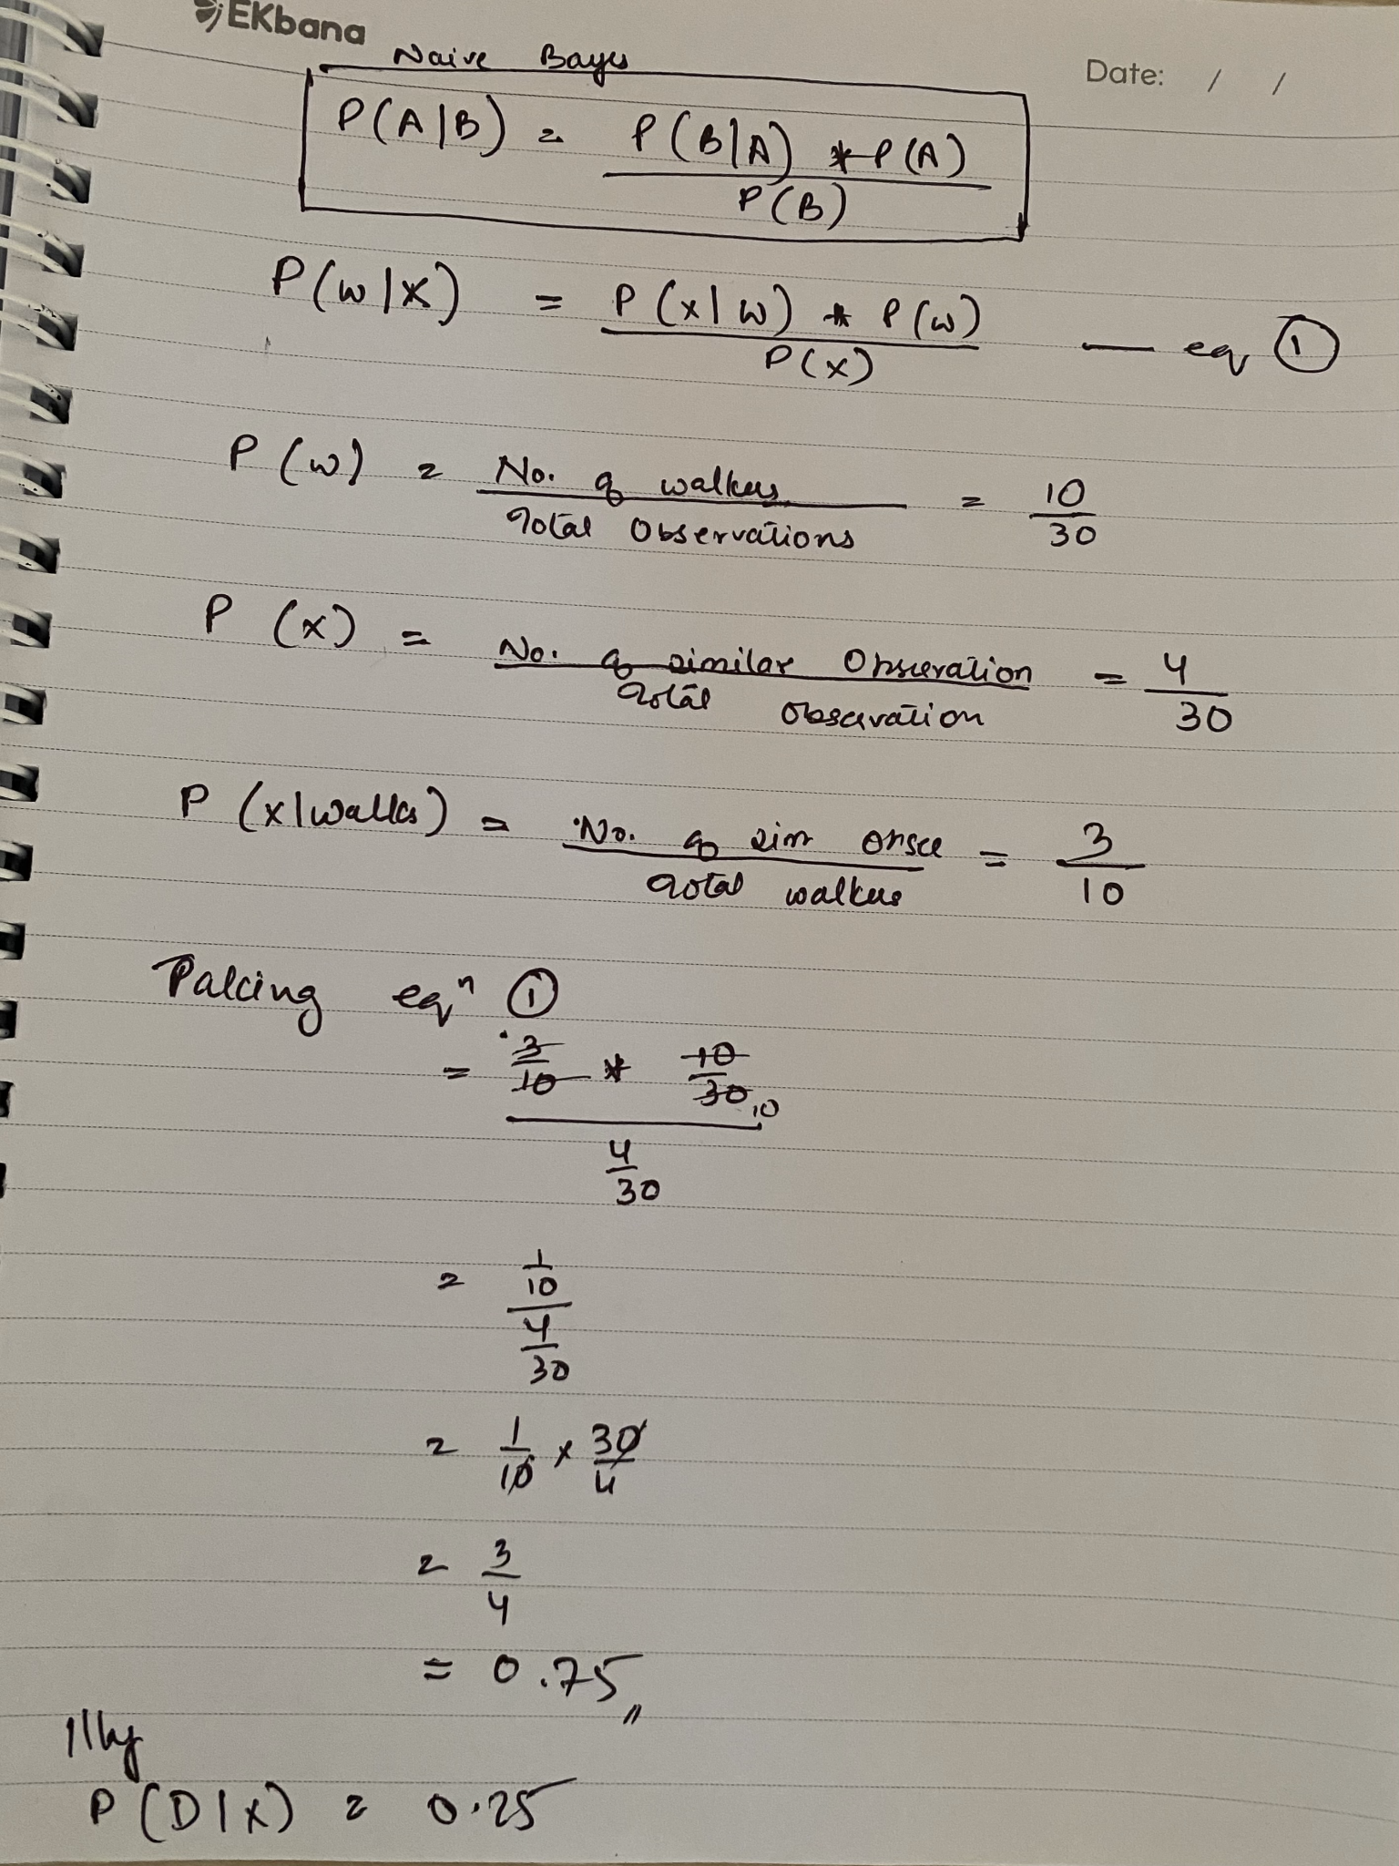
Step by Step
Naive Bayes classifier calculates the probability of an event in the following steps:
Step 1: Calculate the prior probability for given class labels
Step 2: Find Likelihood probability with each attribute for each class
Step 3: Put these value in Bayes Formula and calculate posterior probability.
Step 4: See which class has a higher probability, given the input belongs to the higher probability class.
Notebook Link
Notes:
Src:
https://www.analyticsvidhya.com/blog/2021/01/a-guide-to-the-naive-bayes-algorithm/
https://www.datacamp.com/tutorial/naive-bayes-scikit-learn

Slide 17
To learn more on Machine Learning
Course: https://www.udacity.com/course/intro-to-machine-learning--ud120

Slide 18
4. Learning with Neural Networks
To be Continued in Next Class….

